Slide 1
FACE RECOGNITION & FINGERPRINT IDENTIFICATION
Minor project

Slide 2
introduction
IMAGE PROCESSING
Face and fingerprint image is captured ,processed and enhanced for matching identity with the already saved data in the database.
AUTOMATION
Automated face recognition is used to recognize individuals in pictures or videos. Automated face recognition is frequently utilized in systems like enhanced authentication systems and social media.
SECURITY
Facial identification and fingerprint recognition security systems can uniquely identify individuals during user onboarding or logins as well as strengthen user authentication activity.

Slide 3

Problem statement
Security system with single biometric authentication has many limitations and they can be easily breached by duplicating the biometric of person. So we implemented two different biometric authentication in our prototype to enhance security

Slide 4
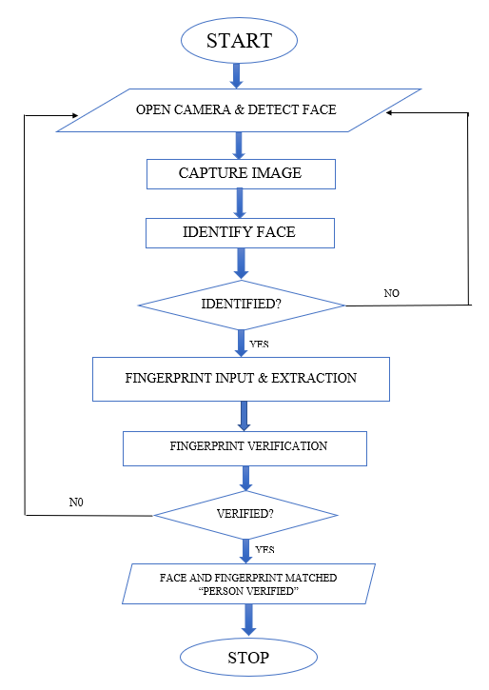
Proposed work

Slide 5
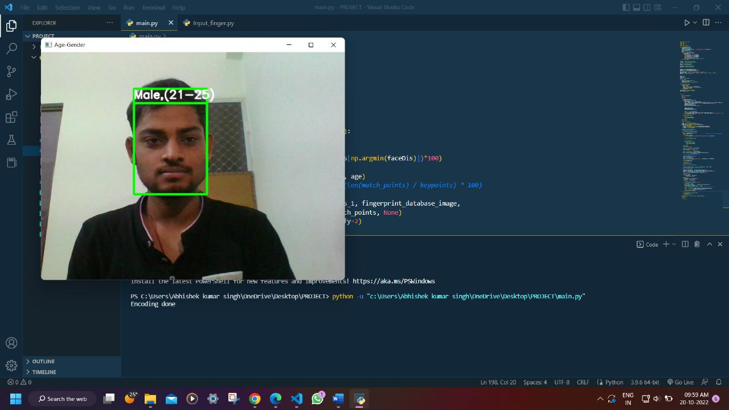
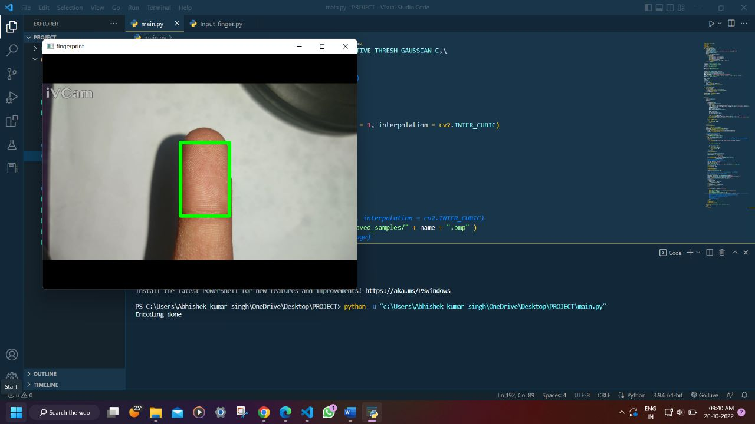
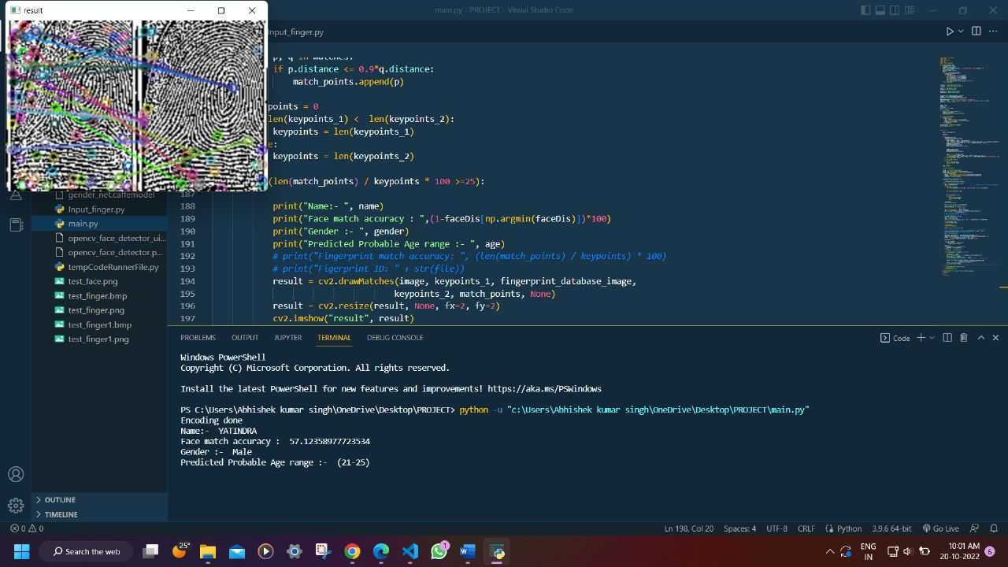
implementation AND RESULT

Slide 6
CONCLUSION AND FUTURE WORK
Efficiency of our prototype is around 60%. We can improve it by using more fingerprint image enhancement techniques . Accuracy of can also be increased with advanced camera and proper lighting. We can also register new person in database using automated code

Slide 7
REFERENCES

Slide 8


